Slide 1


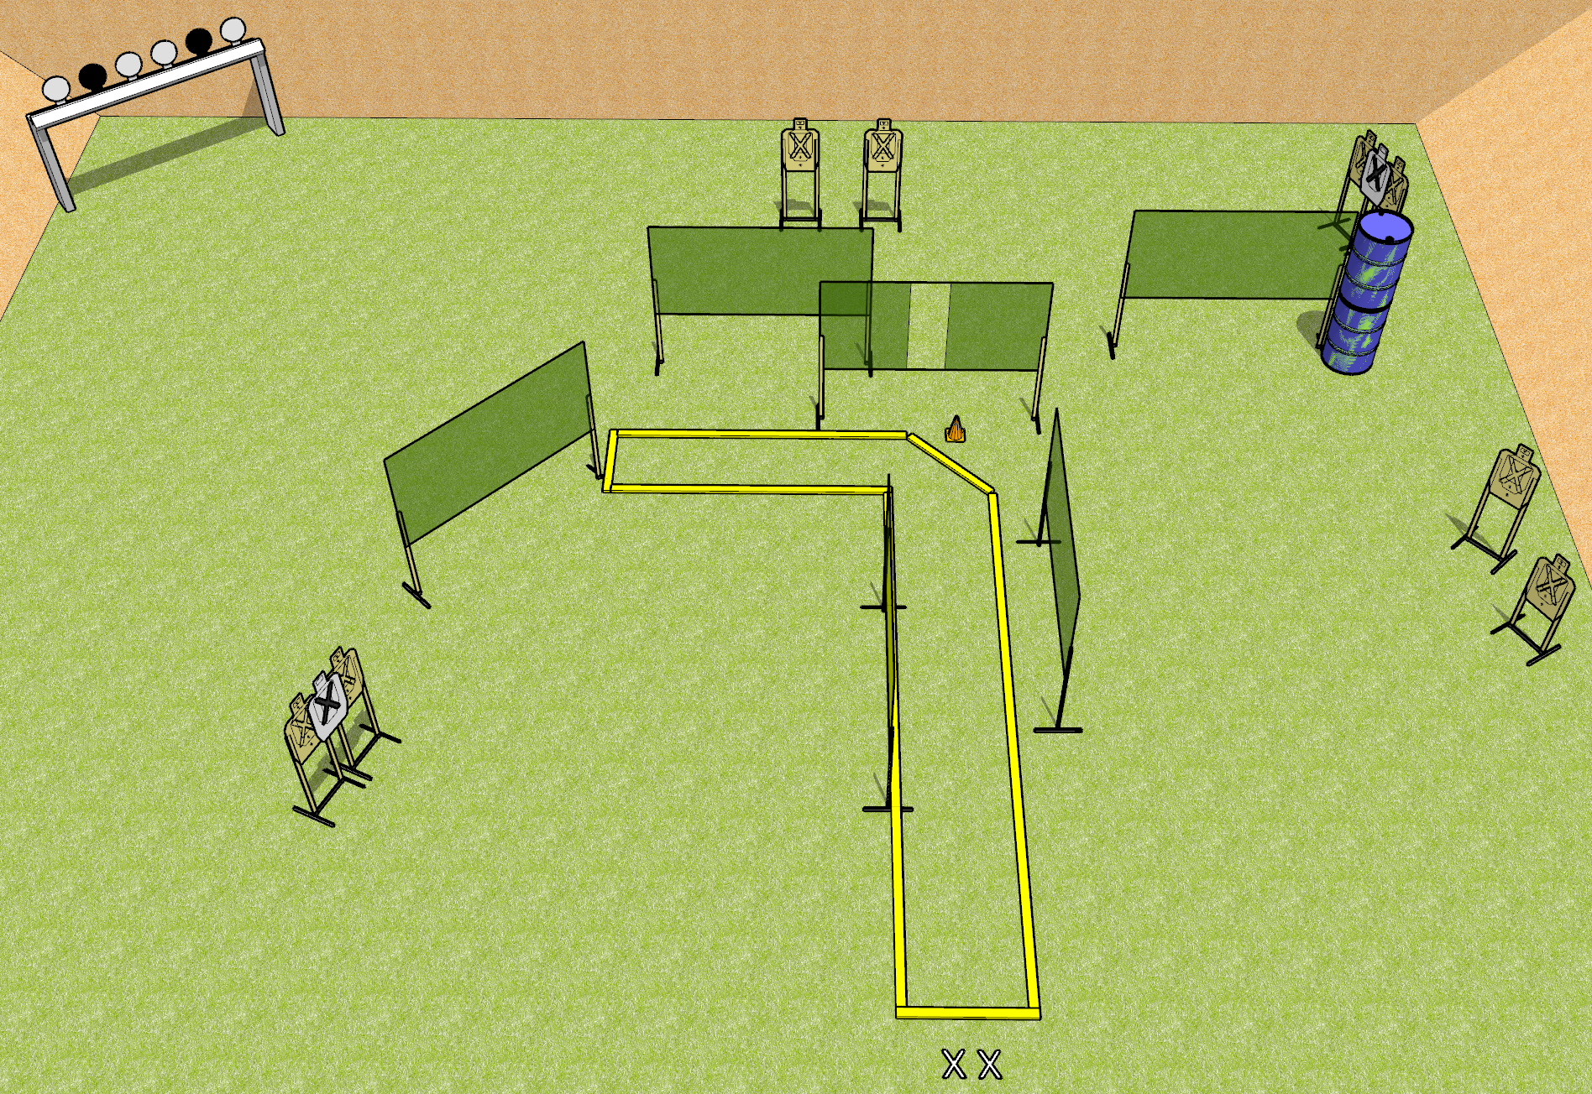
 | Dothan Gun Club – USPSA Match Zach’s Boogie Course Designer : Drew Coleman/Kyle Stroganoff
START POSITION : Standing with both feet on X's.
GUN READY CONDITION : Pistol loaded and holstered. PCC shouldered, safety on, pointed at orange cone. |  | SCORING: Comstock, 20 rounds TARGETS: 8 paper, 4 Steel SCORED HITS: Best 2 on paper, steel until down START-STOP: Audible, last shot RULES:
STAGE PROCEDURE: Engage targets as they become available from within the fault lines.

